Slide 1

BMIS 2003
Blockchain Application Development
Blockchain Durian System
Team Member:
1.Chiew Chin Chong
2.Lim Weng Ni
3.Loh Jian Wei
4.Ong Yee Yung
5.Tan Chee Fung

Slide 2
Introduction
enhances transparency, traceability, and integrity in the durian supply chain
ensures secure and verifiable tracking at every stage
Blockchain Durian Tracking System
tracks the journey from retailer to consumer
data tamper-proof and resistant to system failures or attacks.

Slide 3
Business Rules
Retailer
Consumer
Add harvest information
Verify authenticity
Modify the timelock
View the durian record
Purchase durian
Verify authenticity

Slide 4
Description
Unique Identifier
Transparency and Reporting
Blockchain Durian Tracking System
Data Integrity
Payment

Slide 5
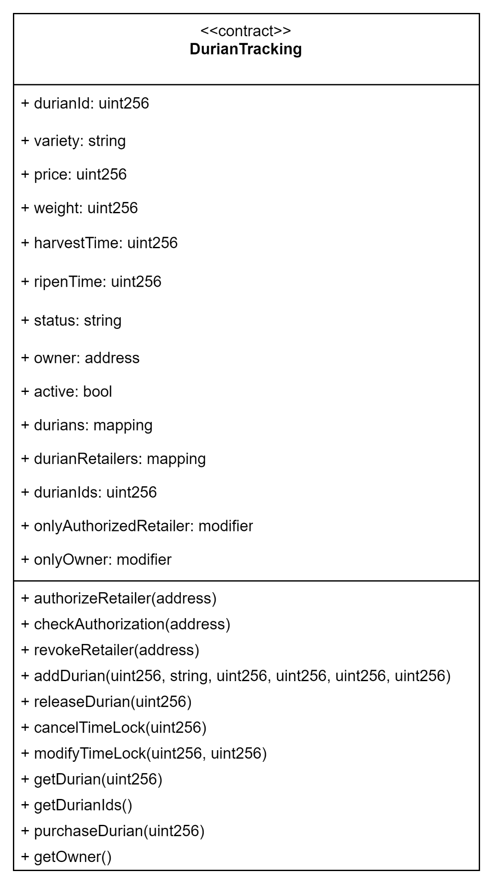
Contract Diagram

Slide 6
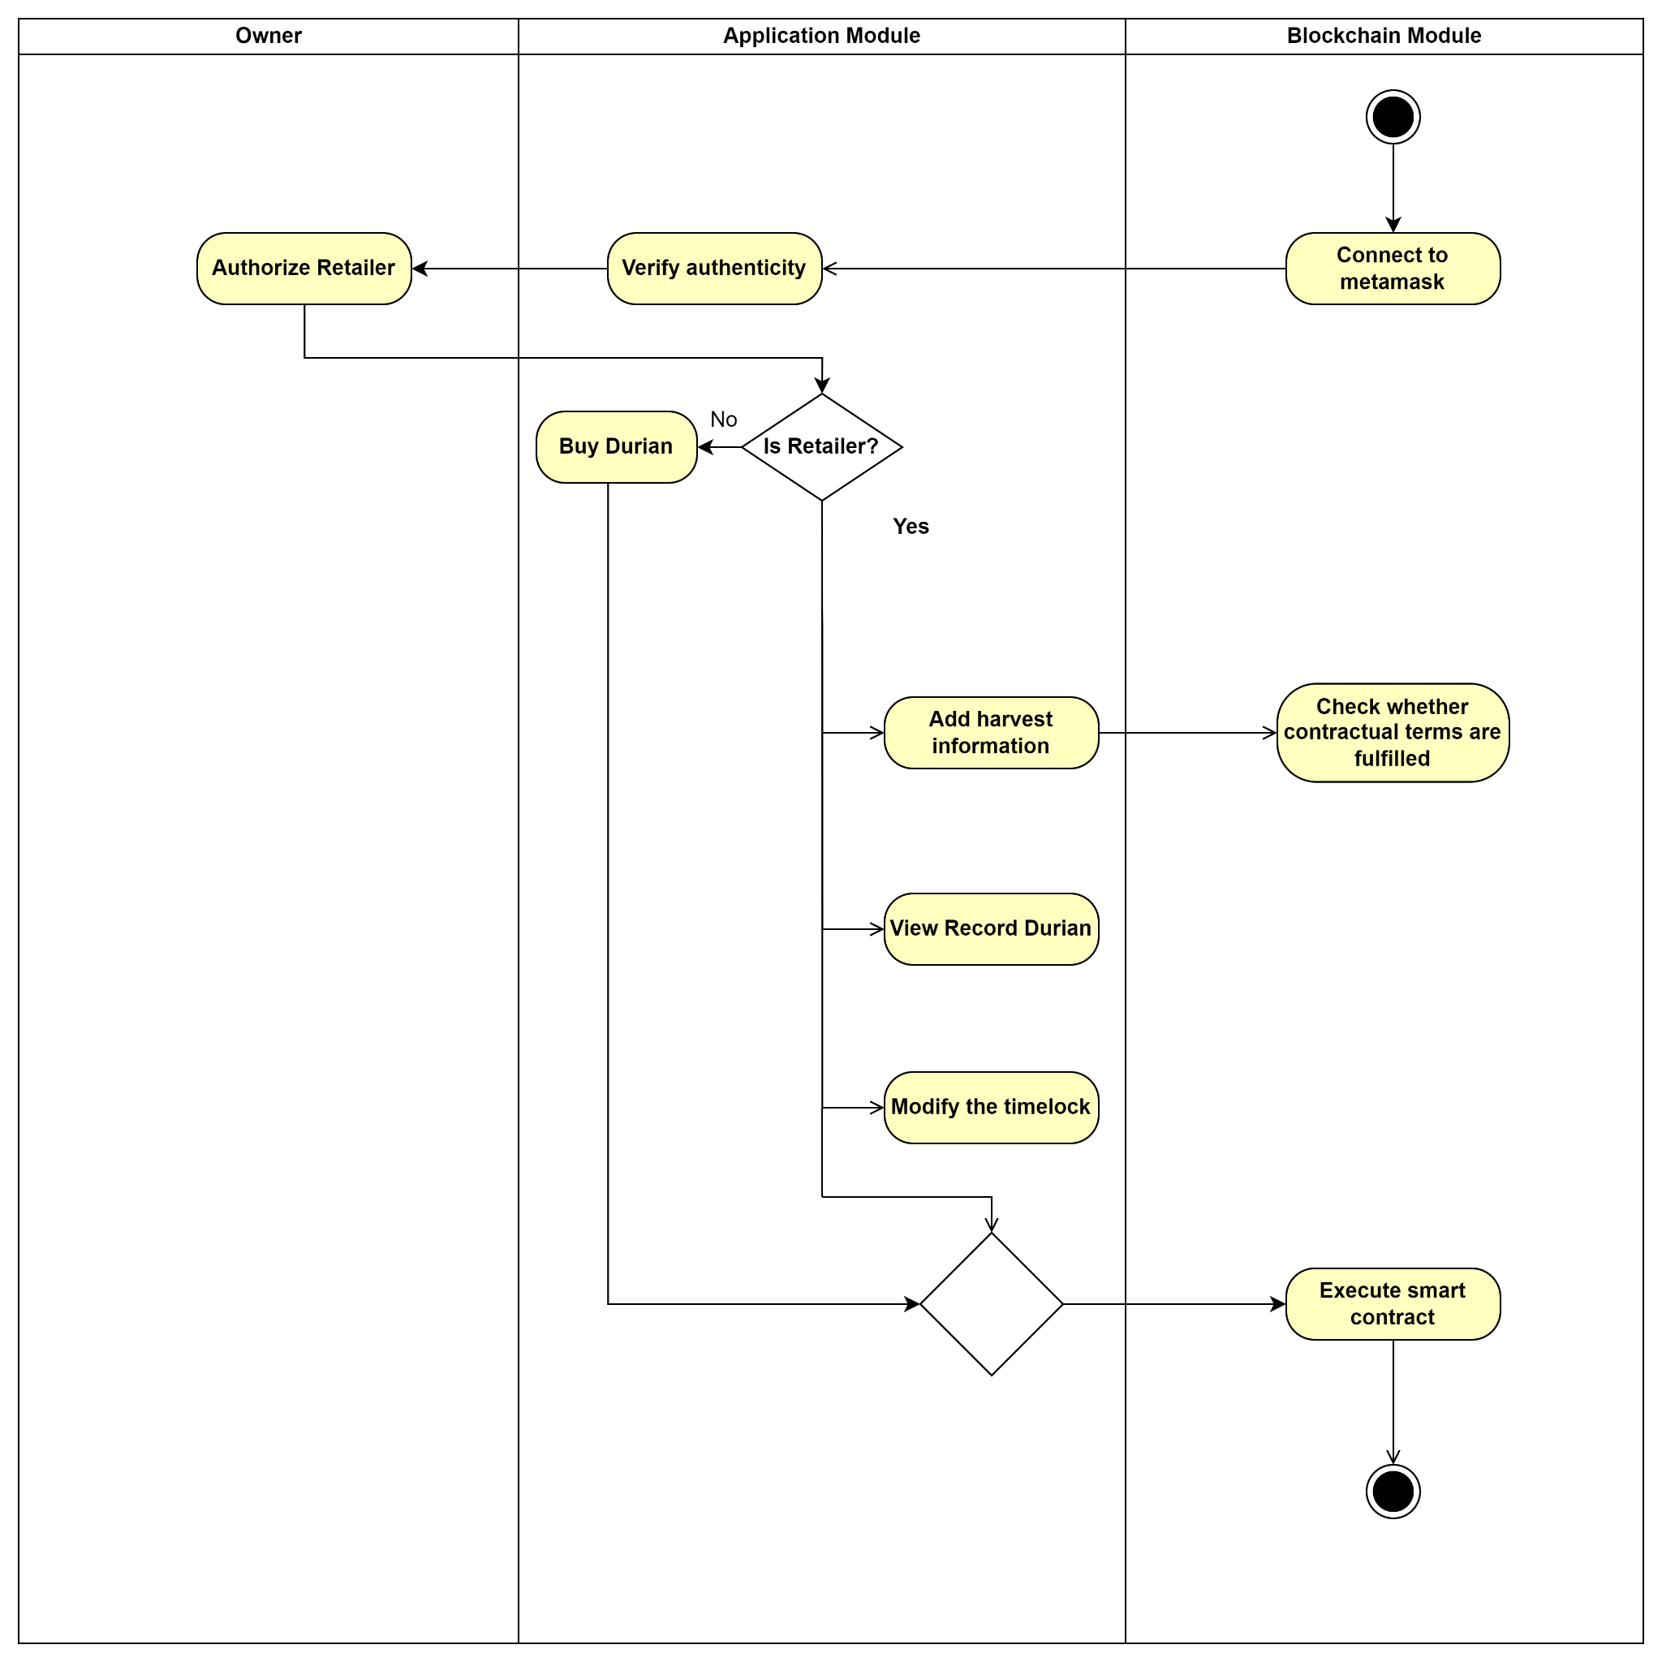
Activity Diagram

Slide 7
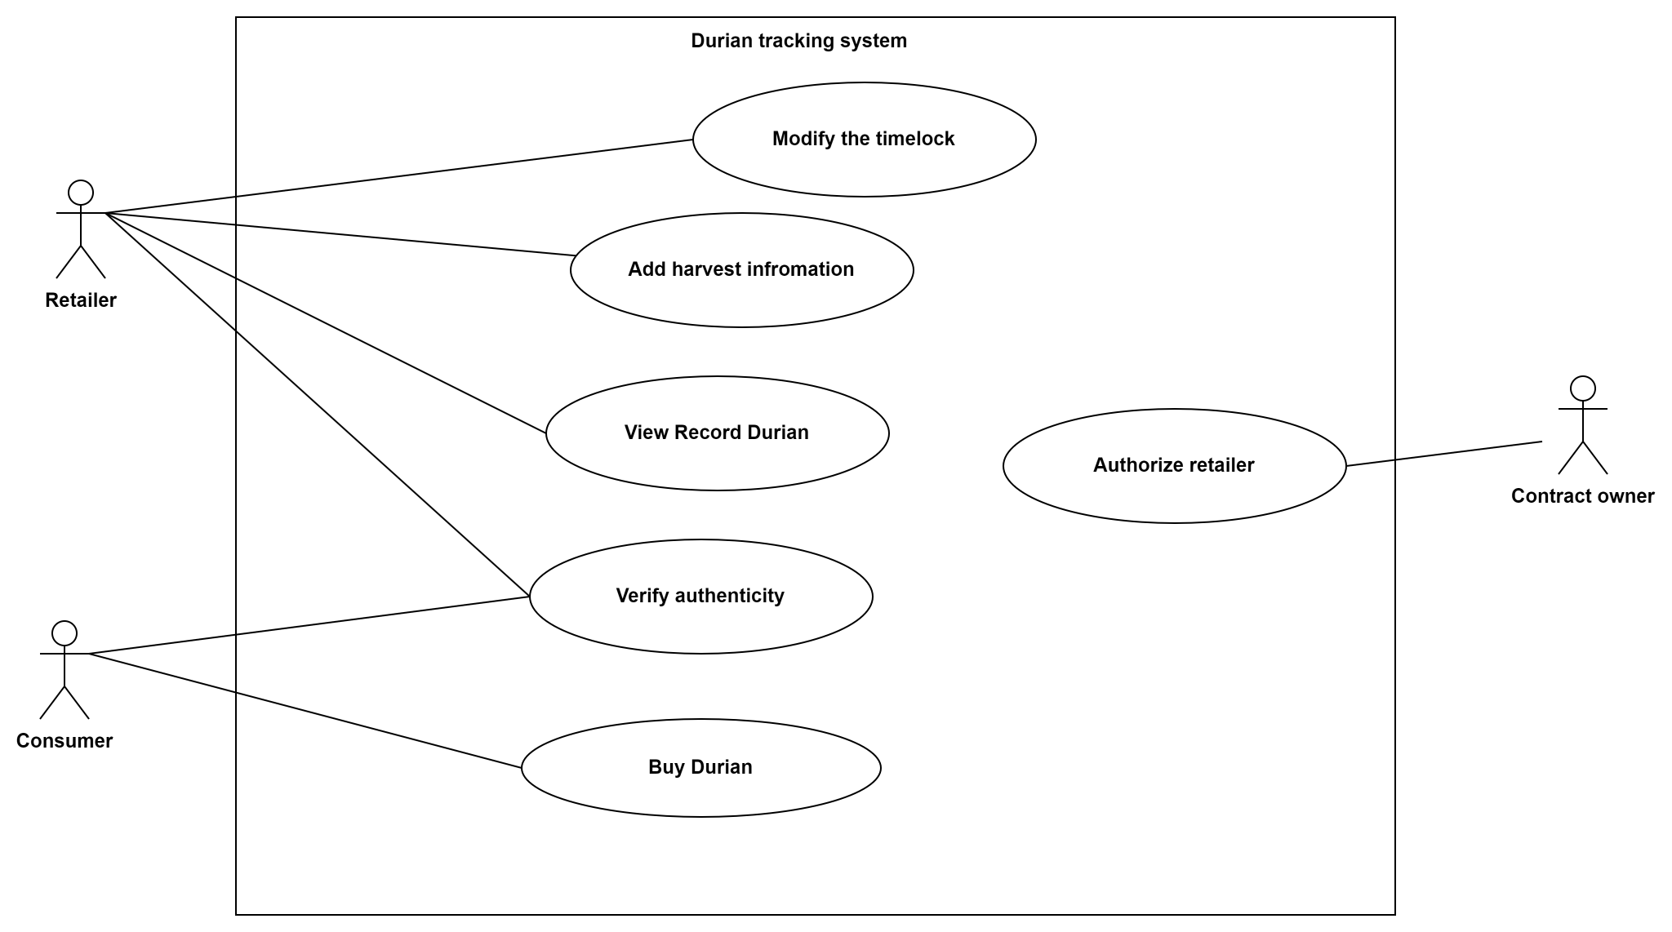
Use Case Diagram

Slide 8
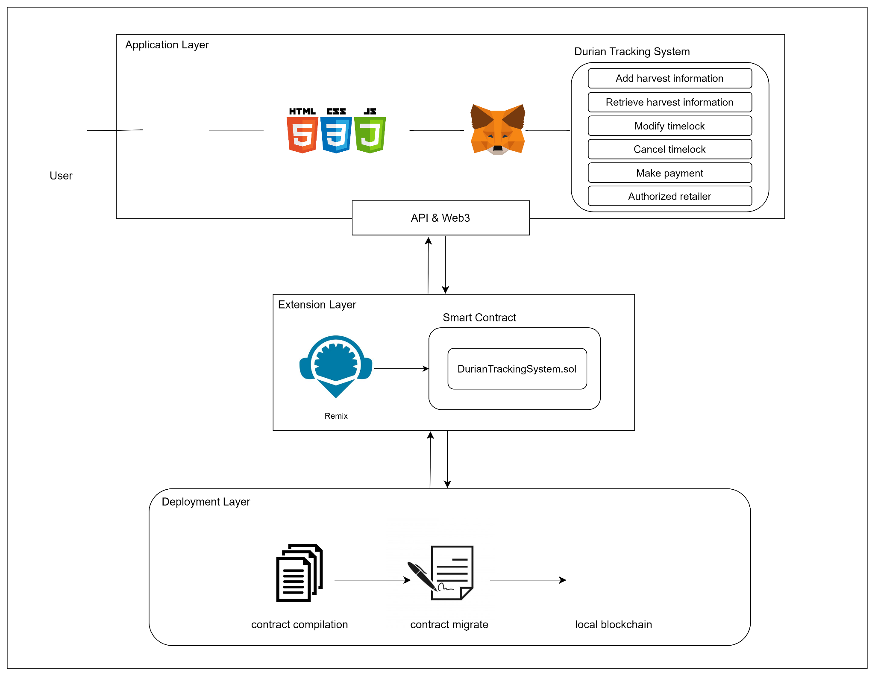
System Architecture/
Design Structure Diagram

